Slide 1
Welcome to Ravenscroft Nursery School
Virtual Open Evening
18th January 2023

Slide 2
Zoom etiquette for this evening
Please keep your mic on mute unless requested to unmute.
A short presentation will be given, screen share will be used for this. A few screens will be shared one after each other.
At the end of the presentation, any questions will be addressed.
You can type questions at any time through the chat feature, they will be kept until the end.
It would be appreciated if you could send your contact details using the chat feature also.
Thank you for joining this evening.

Slide 3
What do we offer?
One of only four Nursery Schools in Inner East Belfast
We offer full time Nursery provision
In a purpose built building, New school building secured in 2009
Fully qualified and highly experienced staff
All have background, experience and further qualifications in Early Years and Teaching in Nursery School settings
Principal led setting

Slide 4
Our recent ETI Inspection found that Ravenscroft Nursery School is:
Outstanding in its Outcomes for learners
Outstanding in its Quality of provision
Outstanding in its Leadership and management
High Level of Capacity for Sustained Improvement

Slide 5
We employ two full time equivalent and 2 part time Nursery Assistants to work alongside teachers in the classroom
We employ a part time assistant to work with our bi-lingual children
We regularly enhance our adult/child ratios through the inclusion of students from local colleges and parent and other volunteers from the local community
We have control of our own delegated budget and supplement this through additional income generation for the benefit of the children

Slide 6
We offer a wide, varied and well resourced curriculum which is based on the NI pre-school curricular guidance
We enhance this through our regular educational visits to places such as the Ulster museum, W5 and Stormont park and by inviting visitors such as Mr Hulabaloo, Science Starz and Cinemagic to the school
We love to have a party and run lots of school/community events such as Grandparents Day, Big Lunch, Christmas party/concert events

Slide 7
Our school day is 9.00 am – 1.30pm
We offer an early morning room from 8.30 am – 8.55am and this begins in mid October. We ask for a small contribution for this service
Parents are very welcome to get involved in the life of the school in any way that they can, covid 19 restrictions permitting

Slide 8
The Teaching Staff
Mrs Symington is a Teaching Principal with 24 years experience in Nursery, nine of those as a Nursery Principal
Mrs Mc Gowan has taught in Nursery for 13 years
Mrs Farren has taught in Nursery for 25 years
All of the teaching staff hold postgraduate qualifications in Nursery Education and specialised in Early Years during their undergraduate studies. They have all undertaken extensive professional development in Nursery and Early years
The Principal holds a PQHNI qualification which is a specialist Headteacher professional qualification

Slide 9
The support staff
Mrs Wright 30 years in Ravenscroft
Miss Steed 18 years in Ravenscroft
Miss Ball 15 years in Ravenscroft
Mrs Gillespie 5 years in Ravenscroft
All are qualified and experienced Nursery Assistants with a wealth of experience and professional development in Nursery School settings
Christine Woodrow
A member of our BOG and a school volunteer

Slide 10
How to apply

Slide 11
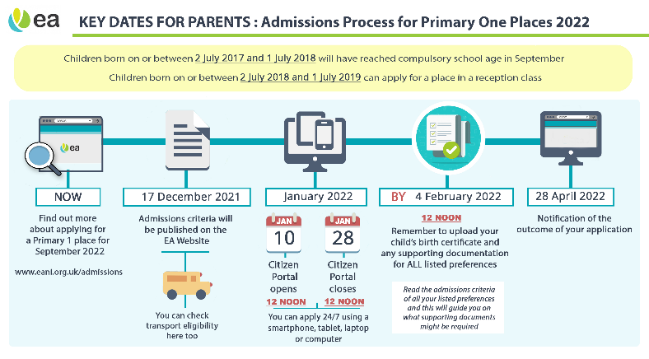
The application process will be online only
The EANI portal can be accessed at:
https://www.eani.org.uk/parents/admissions

Slide 12
This link will be available on our school website
www.ravenscroftnursery.co.uk
The application process goes live from Tuesday 10th January 2022 @ noon
The closing date is Friday 27th January 2022 @ noon.
Application form is only available online

Slide 13
Visit the link below for a quick video guide:
https://www.eani.org.uk/parents/admissions/pre-school-admissions-guide

Slide 14
All supporting documents will need to be submitted to complete your child’s application
Birth Certificates and proof of address documents MUST be submitted directly to Ravenscroft Nursery School by noon on Tuesday 31st January 2023 - further information regarding any additional documents required will be posted on our school website
We are happy to accept any documents relating to your 2nd, 3rd etc preferences and these must be submitted to us in case they are needed to support your application to other settings at subsequent preferences. We advise you to consider these criteria carefully in the event that you are unsuccessful with your 1st preference. For example, if Special Educational Needs is part of the criteria for your 2nd choice, you should attach relevant documentation.

Slide 15
What should I do if encounter any difficulty?
Speak to us. Phone on
02890 471684 or
07553 028074 office hours during any lockdown
We can help you get online to submit your application if needed.

Slide 16
DO NOT DELAY SUBMITTING YOUR APPLICATION

Slide 17
What is the Admissions criteria for Ravenscroft Nursery School?
It will be made available on our website: www.ravenscroftnursery.co.uk and
The EANI website: www.eani.org.uk

Slide 18
Will there be an open day?
Not for the 21-22 academic year
We will hold a virtual Open Evening/Q&A session on Tuesday 12th January 2021 @ 7 – 7.45pm via zoom
A follow up information session and Q&A opportunity will be available on Wednesday 27th January
2.00-2.45pm
Via zoom
Meeting link will be made available on our website homepage on the day of the session

Slide 19
Can I call to the school at any other time?
Unfortunately we are unable to accommodate in person visits at this time.

Slide 20
How will I know if my child has gained a place?
We will write out to successful applicants on Thursday 27th April 2021
(Letters are posted first class on Wednesday 26th April to arrive on Thursday 27^{th April})
Alternatively you can log in to the portal to find out, it will update on April 27th 2021

Slide 21
What happens if my application for Ravenscroft is not successful?
Your application will be considered by your second and/or subsequent school preferences
No application to Ravenscroft is guaranteed so please ensure you have nominated additional school preferences on your application form
Further information is on the application portal

Slide 22

Good Luck with your application

